Slide 1

TBD
Credit Card Fraud Detection
August 2023

Slide 2
AGENDA
1
Meet the team
Business Context
Delivery Methodology & Outcomes
Use Cases & Success Stories
Our Offering Summary
Q&A
3
2
4
3
5
4
6
5
7
6
8

Slide 3



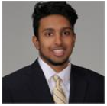

MEET OUR TEAM
Who we are and what we are here to deliver
V
Zomi Yao-Bai
Consultant AI Professional
Human Capital
zyaobai@deloitte.com
Jasmine Baker
Analyst AI Professional
Advisory
jasbaker@deloitte.com
Shane Reichlin
Analyst AI Professional
Advisory
sreichlin@deloitte.com
Nikhil Manimaran
Analyst AI Professional
Advisory
nmarimaran@deloitte.com
Transform
Operate
Empower
Notes:
Drive transformation
Streamline Business Operations
Enhance Customers Experience & Loyalty

Slide 4







BUSINESS CONTEXT
Why Use AI in the Financial Services & Insurance Industry?
Retail Banking Transactions Support
Customer Due Diligence Reporting
Provide human-like support for complex retail transactions including customer applications, questions, negotiations, and more
Generate reports on new customers such as KYC processes and summarize them for employees to action and make decisions for customer onboarding
Database Search
Claims Footage
Query massive financial transaction databases to find specific items and insights using natural language instead of database languages such as SQL
Review video footage of claims(e.g., car crashes / ATO complaints) to pull out summaries and eventually generate new video of potential crash or impersonate transactions scenarios..
Fraud Detection
Financial Model Enhancement
Generate customer signatures to enhance internal fraud models in areas such as Credit card authorization, and summarize potential fraud hotspots
Generate synthetic data to improve and enhance financial models and pressure test an institution’s liquidity and processes
CREDIT CARD FRAUD DETECTION
Notes:
Today’s Focus: Credit Card Fraud Detection
In December 2022, the Nilson Report, which monitors the payments industry, released a forecast indicating that U.S. losses from card fraud will total $165.1 billion over the next 10 years, plaguing every age group in every state.

Slide 5
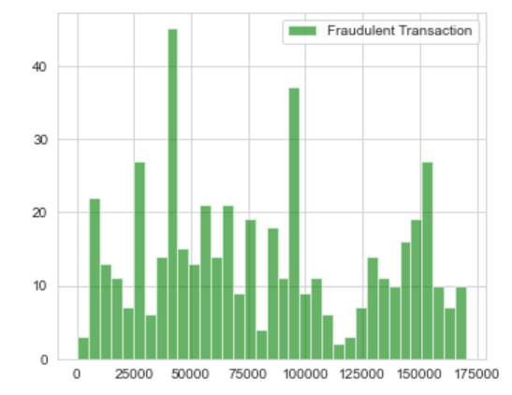
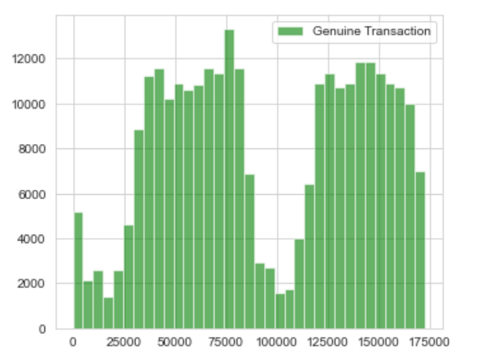
DELIVERY METHODOLOGY & OUTCOMES
Holistic Approach and Strategic Focus on Efficient Solution
Problem Identification
Fraudulent transactions: 0.17%
Genuine transactions: 99%
Anomaly detection in fraudulent transactions can be harmful to your organization.
Problem
Assessment
Deep Dive into Minority Class
Goal setup: Capture more or all fraudulent transactions
Problem Resolution
Integrated Most Accurate Fraud Detector
Model correctly identified fraudulent transactions with over 99% accuracy
Address this issue
Using AI integrated techniques
Incorrectly flagged 25 legitimate transactions
End-User was given a chance to confirm or deny transaction
A. Fraudulent Transactions
B. Genuine Transactions
Notes:
Holistic Approach & Strategic Focus on capturing fraud transactions
Out of 284,807 transactions received, only 492 of them were identified as fraud.
Incorrectly flagged 25 legitimate transactions can be reprocessed once the card holder confirm his/ her accountability for the purchase

Slide 6
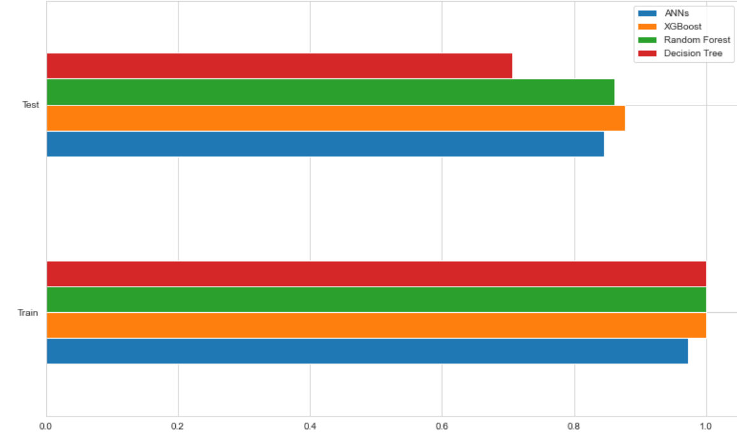
USE CASES & SUCCESS STORIES
What impact on the business and consumers?
Challenge
Approach
Impact
Inefficient Transaction Processing System
Increase in Customer Dissatisfaction
Decrease in Company Revenues & Customers
Breach in Security System – Increase in Identity Theft
AI integrated solution flagging suspicious transactions
AI-enabled performer to capture the most out of fraudulent transactions
Automatic response sent to account holder
99% of users reported a “good” experience with the institution
84% initiated loans based on rise of credit score
98 % Customer complaints on unauthorized transactions rate decreased
Best Performer – Solution Model

Slide 7




OUR OFFERING SUMMARY
With our AI professional team
.
Services + Solutions
Automate Operational Tasks Integrated with AI
Engage with TPS for Frontline Support
Deliver Meaningful insights and Identify Opportunity
Generate Work Output Using Deep Learning Models
ADVISE
IMPLEMENT
OPERATE
ECOSYSTEM
Conduct cost benefit
analysis related to false positives/negatives
We have a differentiate POV & approach to help create n immediate and sustained value
We partner across the firm to deliver a variety of automation, AI packages & customer solutions
We can operate on Conversational AI, Machine Learning, Cognitive Analytics
We can leverage your alliance relationships and integrate your current ecosystem to create new markets
Notes:
TPS – Transaction Processing System

Slide 8
Q & A
Notes:
Presentation aims to create a

